Slide 1
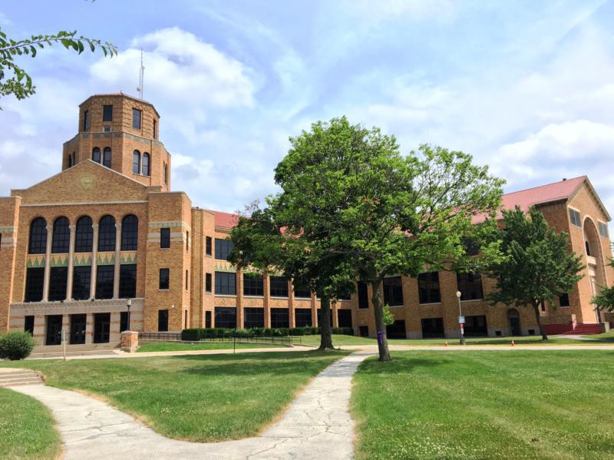
Maine East High School

Slide 2
History
Maine East High School has been part of ISPIC since 2003. Dr. Shook-Orr has typically supervised 2 interns per year.
Yearly Stipend: $20,000
Interns have an office among the School Psychologists and Social Workers in Guidance.
Interns are an integral part of the SPS staff at Maine East. They are included in all site activities and communication, and are treated the same as other School Psychologists and Social Workers (but with a lighter case load!)
Interns work and collaborate with not only their supervisor, but also counselors and social workers

Slide 3
Intern’s typical week of training
About 10 special education initial and/or re-evaluation assessments per year
Case load of about 10 individual counseling cases, and multiple groups
Member of the Professional Learning Team and a Student Assistance Team
Attend all meetings with other SPS staff (e.g., department meetings)
Assist with schoolwide initiatives (e.g., social-emotional screening, Signs of Suicide, PBIS)
Conduct risk assessments as necessary
Conduct assessments and/or attend staffings at Private Catholic High School
Summer:
  Interns work with students in Extended School Year Program (from all three high schools in District 207)
  This year, one intern also helped with groups in District 64
  Interns are also available in the guidance department to assist with crisis situations

Slide 4
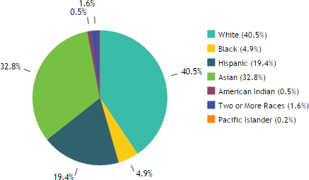
Demographics – Maine East High School
Maine East High School is officially a language minority school, and educates students who speak 51 languages.
In 2015-2016, 75% of students came from homes where English was not the primary language, and 10.4% were English Learners.
45.6% of students were from low income households. Of the student population, 40.5% were White (including Middle Eastern), 4.9% were Black, 19.4% were Hispanic, 32.8% were Asian, 0.5% were American Indian, 1.6% were two or more races, and 0.2% were Pacific Islander.

Slide 5
Intern’s typical week of supervision
Interns receive two hours per week of supervision from a licensed clinical psychologist.
Additionally, group supervision is conducted with the supervisor (licensed clinical psychologist), school psychology interns, and the social work intern
Dr. Shook-Orr and other school psychologists are available every day for extra support, as requested
Interns complete their 20 day rotation with District 64 and work with Dr. Bill Connor

Slide 6
Ruth Shook-Orr, Psy.D., NCSP
Licensed School & Clinical Psychologist
1.0 FTE employee

Slide 7
Supervision
Individual supervision occurs in Dr. Shook-Orr’s office
Group supervision occurs in either the school psychology
interns’ or social work intern’s
office

Slide 8
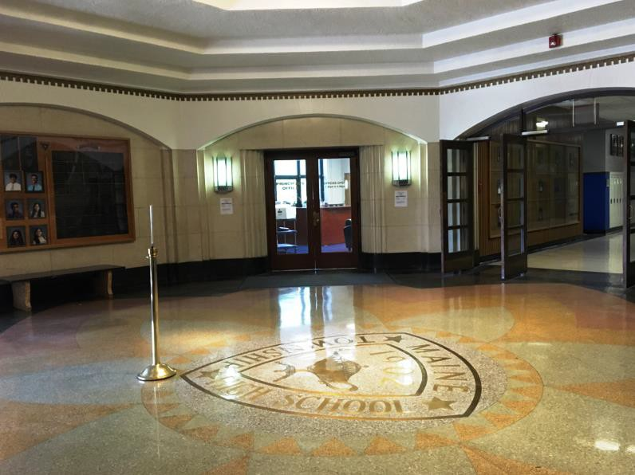
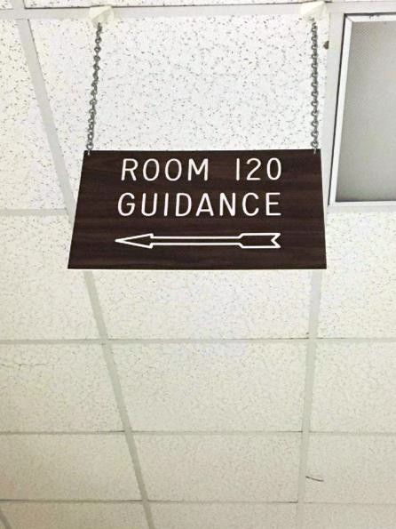
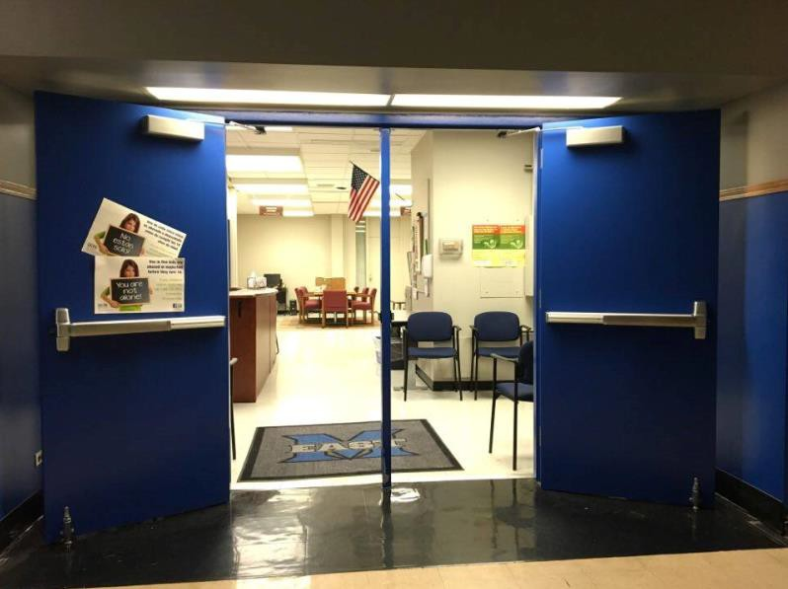
Main Office
Visitors check in at the Maine East main office in the rotunda
The interns’ office is located in the Student Services Department, near the offices of the School Psychologists and Social Workers
Secure student documentation is kept in various offices (e.g., special education files are locking in the special education department).
Locked filing cabinets are also available in the intern office.

Slide 9
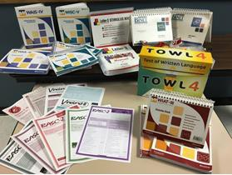
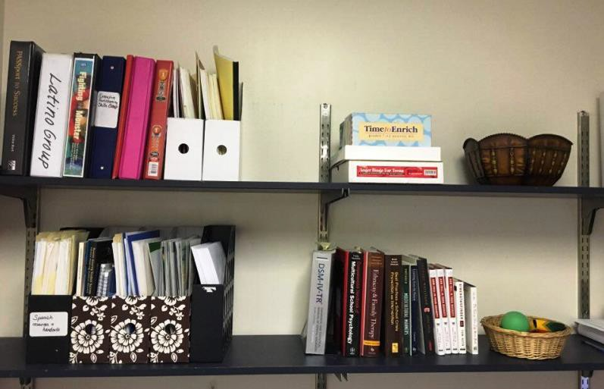
Materials
Interns have access to a variety of assessment kits and rating scales extra (e.g., WISC-V, WIAT- III, Vineland-II, TOWL 4)
There are also intervention resources available in the intern office (e.g., The C.A.T. Project and Strong Teens)

Slide 10
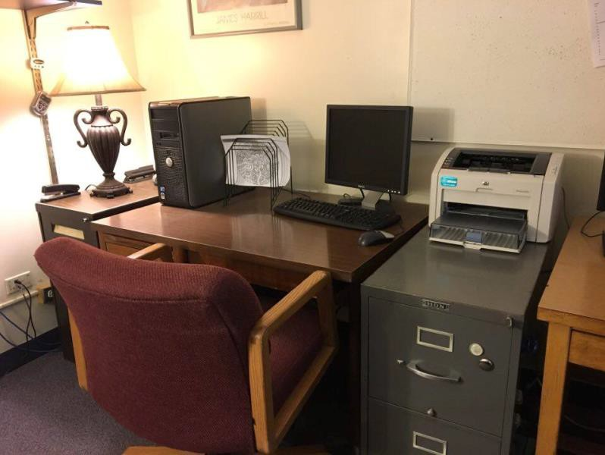
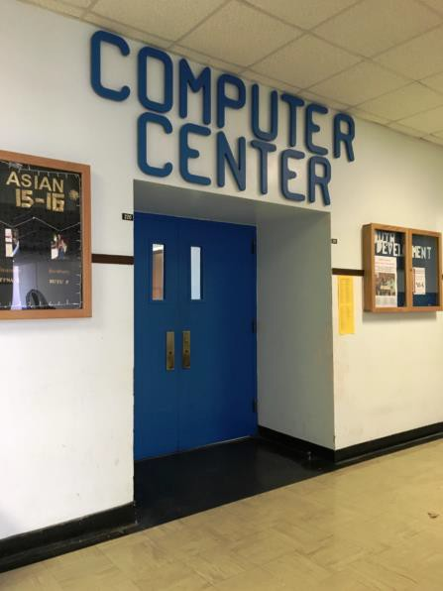
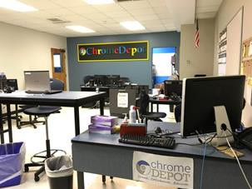
Equipment
Interns share a fully equipped office, with a desktop, printer, filing cabinets, telephone, a variety of informational and intervention materials, and other supplies (e.g., stickers, colored pencils, stapler)
Chrome books are available upon request for interns to use
Interns also have access to tech support through the Chrome Depot on campus

Slide 11
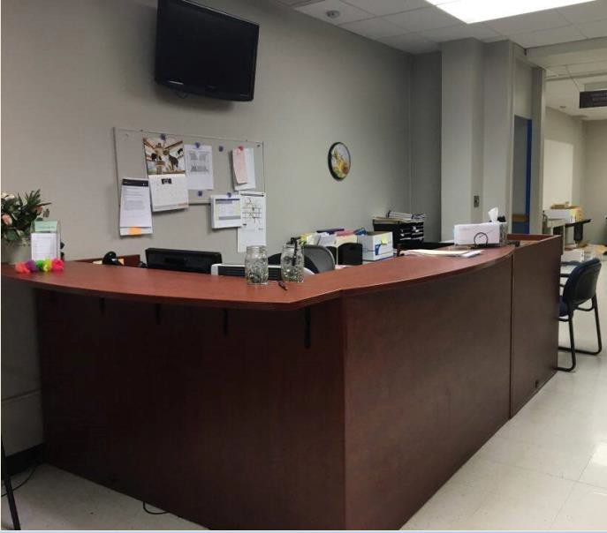
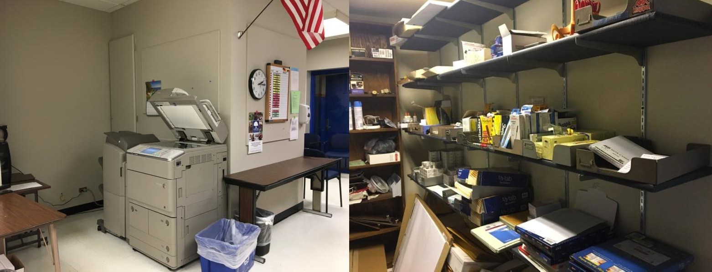
Clerical Support
Interns have access to office materials and equipment (e.g., copier, fax machine, scanner) in the Guidance Department
Clerical support is available to interns, as needed

