Slide 2
Medical Humanities Retreat
February 5 & 6, 2016
The Heart of a True Physician
With DR. HÉLIO ANGOTTI-NETO

Slide 3
The Heart of a True Physician
Come and explore what it means to have the heart of a true physician, what genuine love looks like in medicine and how the scripture can shape the work we do and the ways in which we are called to serve.
All Baylor students and faculty are welcome!

Slide 4
Details….
When: Friday, February 5 & Saturday, February 6
Where: Truett Seminary, Baylor University
Who: All students are welcome (not just Medical Humanities majors!)
Cost: Only $15 covers all meals, sessions & activities
Bonus: Free T-shirts to first 50 registrants!
Transportation: No need, it’s on campus!

Slide 5
Activities…
Outstanding Talks & Presenters
Get to know your faculty members
Fun with other Pre-Health students
Q&A with panel of Baylor alumni
Music
And more!

Slide 6
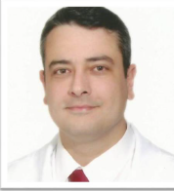
The Heart of a True Physician
Dr. Neto is our keynote speaker, an ophthalmologist & Dean of UNESC Medicine School in Brazil. Dr. Neto speaks and writes extensively about the intersection of Christianity and medicine and it will be an honor to have him with us at Baylor University.

Slide 7
Retreat Schedule
FRIDAY
SATURDAY
5:30 Registration
6:00 Welcome, Invocation, & Dinner
7:00 The Heart of a True Physician with Dr. Helio Angiotti Neto
9:00 Vespers
8:00 Breakfast
8:30 Morning Prayer
9:00 Guest Speaker: Dr. Neto
10:00 Breakout Sessions
11:00 Medical Student Q&A
12:00 Lunch

Slide 8
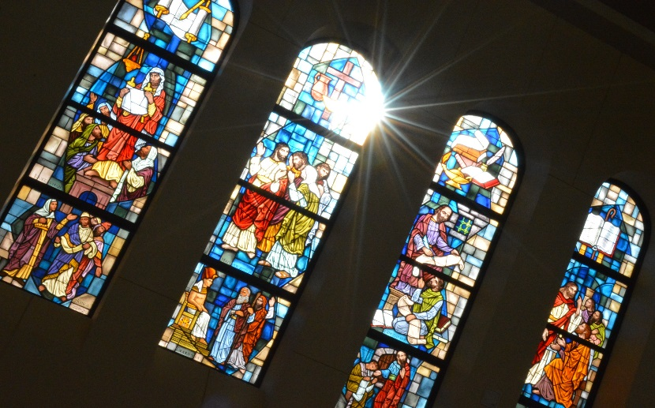
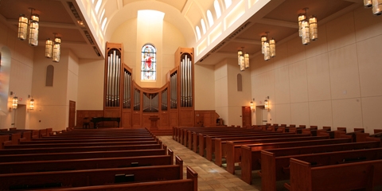
Truett Seminary

Slide 9
What students are saying….
“It was absolutely more than I expected. I got to meet really cool people, listen to fantastic speakers and just enjoy spending time with people outside of the classroom. It was a quiet, relaxing retreat…”
“It was so refreshing to listen to all the speakers. I really enjoyed the topics and was so graciously reminded of my purpose... This retreat made me excited to get into my career and serve through that process.”
“I am taking away wonderful memories, lots of new meaningful relationships and valuable advice from our wise speakers.“

Slide 10
The Heart of a True Physician
February 5-6, 2016 at Truett Seminary on Baylor’s campus.
This event is open to students and faculty from all over the university—and to our alumni!
For only $15, you will receive all meals, sessions and activities.
Free T shirts for the first 50 registrants!

Slide 11
For more information & to register…
On-Line Registration at www.baylor.edu/medical_humanities
Come by the Medical Humanities Office
Baylor Science Building, room D108
Or contact Sue Mock at 710-2065 or Sue_Mock@baylor.edu

