Slide 1
Banking and Cell Phones
ELP 2017

Slide 2
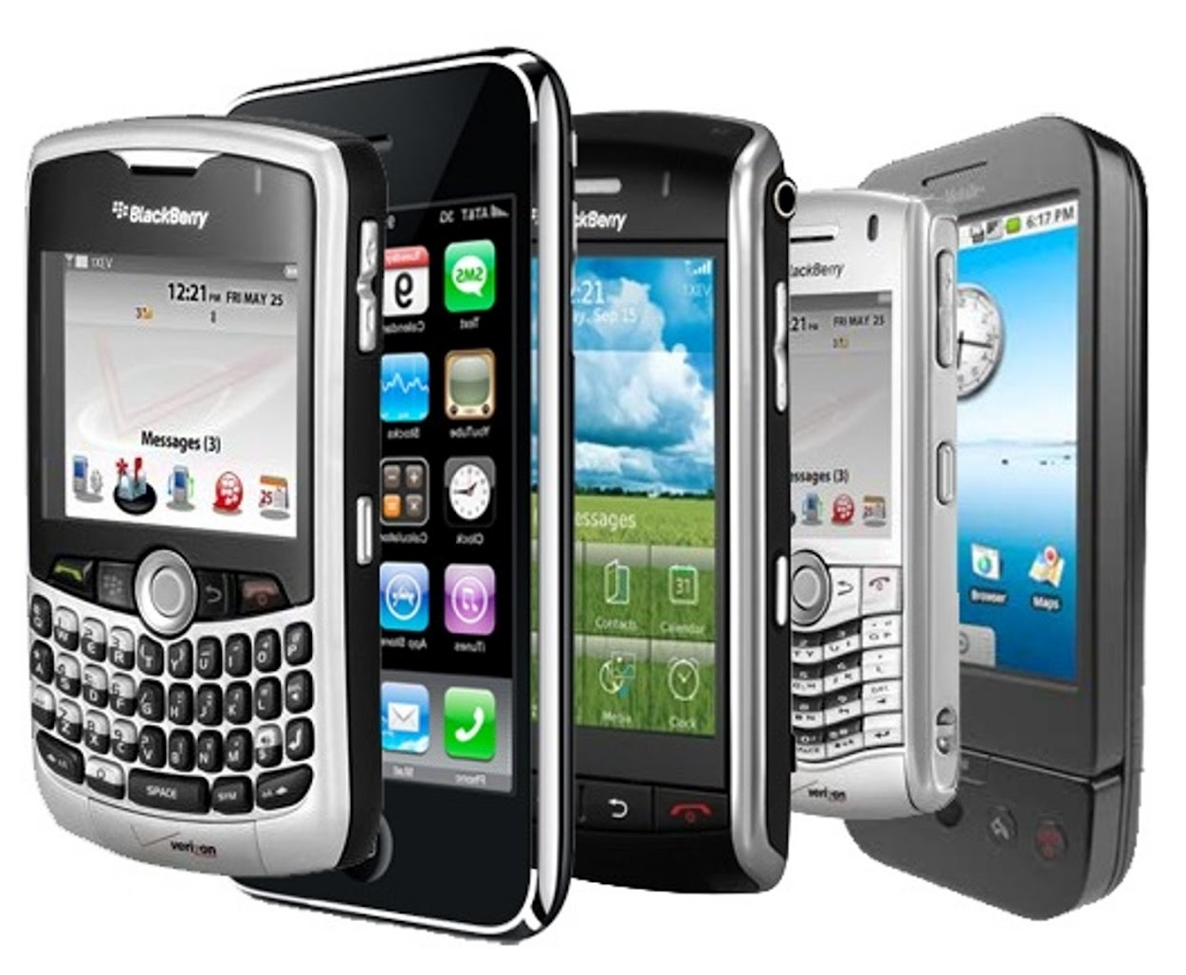
Cell Phones/ Mobile Phones
Notes:
most of you are probably familiar with cell phone service in your home country, the cell phone providers and plans in the United States may be working differently.

Slide 3
Major Carriers in the US
Two basic technologies in mobile phones: CDMA and GSM
Easier to swap phones on GSM networks
With CDMA you can only switch phones with your carrier's permission
GSM = AT&T, T-Mobile
CDMA = Sprint, Verizon, US Cellular
Notes:
Also Boost mobile
-Check with other students and colleagues, particularly those from your home country, for suggestions.
-If you want to switch phones often, use your phone in Europe, or use imported phones, just go with AT&T, T-Mobile, or virtual carriers on those networks

Slide 4
Ways to get a phone
Bring a phone from your home country and purchase a SIM card
Need a code to unlock your phone
Student discounts from US Mobile (https://www.usmobile.com/student-discount)
More info at Yale’s OISS website
Buy a phone in the US
Notes:
http://oiss.yale.edu/life-at-yale/practical-matters/cell-phones#terms

Slide 5
Where to get a phone
Stores around New Haven
Apple (65 Broadway)
AT&T (936 Chapel St)
Cricket Wireless (87 Church St)
Elm City Wireless (210 Whalley Ave)
Metro PCS (80 Church St)
Sprint (908 Chapel St)
T Mobile (109 Church St)
Target
Notes:
Target has a mobile phone section as well

Slide 6
Types of Plans
Prepaid / Pay-as-you-go
Monthly contract
Same services as contract plans do, but usually at higher rates
Do not require a Social Security number (SSN) and/or a credit history check
No long-term contracts, security deposits, or penalties for cancellation
Lower monthly rates and lower prices on new phones
Best prices offered to customers who sign two-year contracts
Without SSN, may need to put down a security deposit
Cancellation fees
Be sure that you understand all requirements and fees before signing a contract!

Slide 7
International Student Programs
Just show passport with student Visa page
E.g. Verizon
https://www.verizonwireless.com/solutions-and-services/international-student/
To avoid problems while traveling outside of the US
Can suspend service when leaving the country
Set up autopay

Slide 8
Other things to be aware of
Most companies charge for all calls, outgoing AND incoming, and data. They may have free calling within their network though
Some plans give you a set number of minutes per month. Overage minutes are charged at a much higher rate
May ask for a proof of your address if you are signing up for a contract
letter or utility bill that has been mailed to your current US address
Some cell phone companies sell only cell phones that work in their network

Slide 9
Oops!
Phone N’ Computer Repair Center
55 Whitney Ave
Fix Wireless
53 Whalley Ave
Ask about warranty when purchasing

Slide 10
Banking

Slide 11
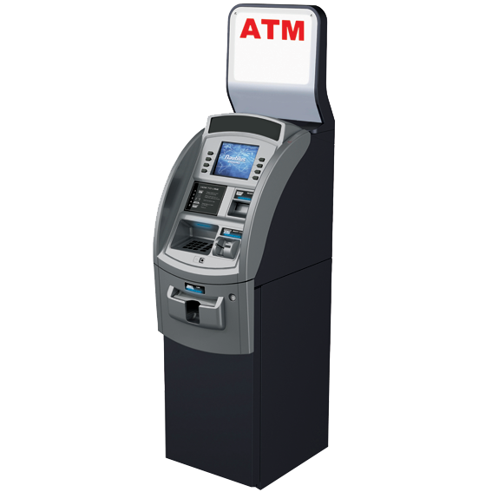
Choosing a bank
Shop around and ask about special offers for Yale students
May waive fees if you arrange direct deposit with Yale
Look for ATMs near where you work/live
Notes:
Many banks offer free or discounted checking accounts for students and employees, particularly if you arrange for direct deposit.
-Fees for ATMS not affiliated with your bank

Slide 12
Bank locations

Slide 13
Opening a bank account
You will need:
Two forms of photo ID. You can use your Yale ID and passport
Immigration document (I-20 or DS-2019)
Proof of your local New Haven address
You will fill out a W-8, which is a statement of foreign residence in lieu of presenting a Social Security card.

Slide 14
Checking vs Savings
Checking Account
Savings Account
frequently take out money, with few restrictions on the timing
make payments with a checkbook, debit card and even mobile apps
usually carry fees
harder to withdraw directly (not linked to ATM card etc.)
need to visit the bank to withdraw or transfer funds
accumulate interest

Slide 15
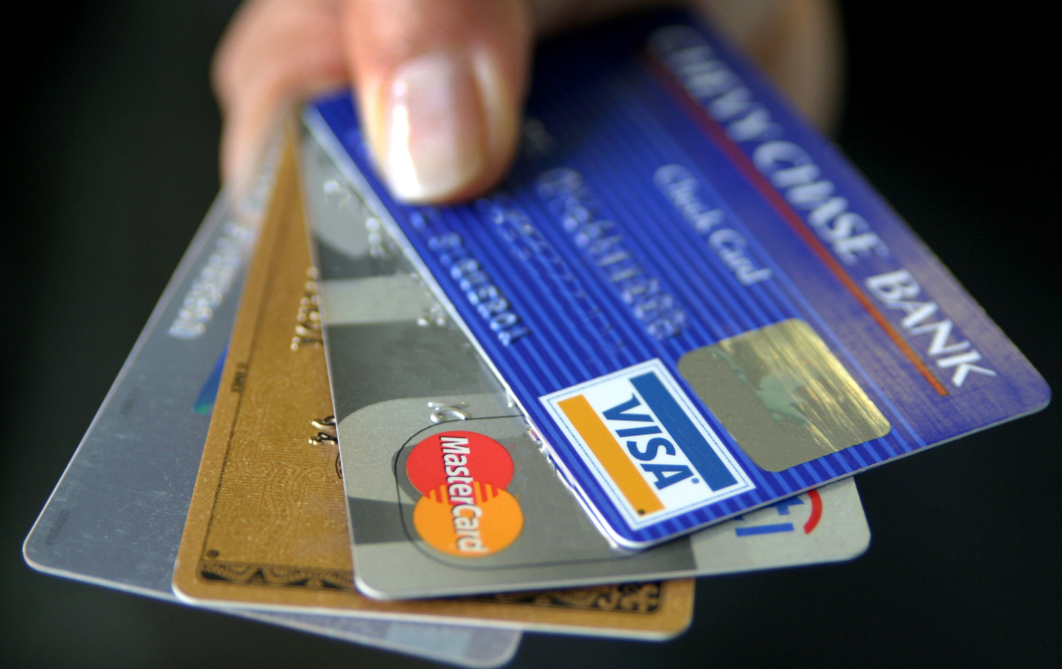
Other things to know
Some accounts require a minimum balance
Ask about transferring funds to/from overseas - some banks can accommodate this better than others
ATM card is not a credit card
Notes:
Be sure to ask about fees for minimum balance, checking etc. when you open the account to avoid surprises

